Slide 1
Who created the first model of DNA
Agenda for Tuesday Dec 9th
Quiz
DNA Replication

Slide 2
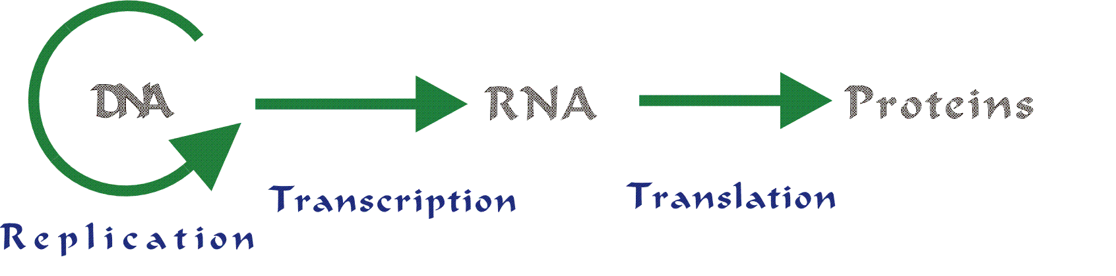
Central Dogma

Slide 3
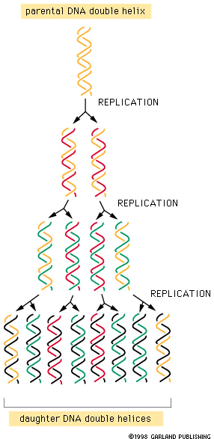
Semiconservative Replication

Slide 4
Replication
DNA Helicase unzips DNA
RNA Primers bind to DNA strands
DNA Polymerase adds nucleotides to DNA
  Leading – continuous adding of bases
  Lagging – Okazaki fragments
DNA Ligase fills in gaps

Slide 5
DNA Replication
Two strands open forming Replication Forks (Y-shaped region)
New strands grow at the forks
3’
Parental DNA Molecule
5’
Replication
Fork
3’
5’

Slide 6
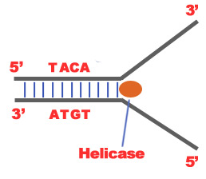
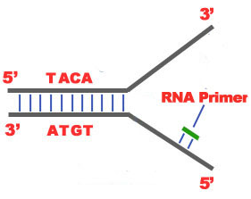
Unwinding
DNA Helicase unwinds/unzips DNA strand
  Hydrogen bonds are broken
RNA Primase adds a starter segment to each strand

Slide 7
Base Pairing
Steps
DNA Polymerase adds nucleotides to DNA strands
  DNA polymerase can only add nucleotides to the 3’ end of the DNA
  This causes the NEW strand to be built in a 5’ to 3’ direction
    Adds a 5’
  Q: Will the strands be identical?

Slide 8
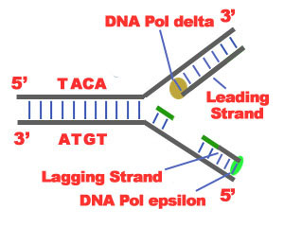
Leading Strand
Replicated as the DNA unwinds
New nucleotides are added continuously

Slide 9
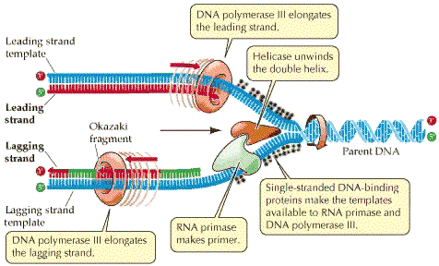

Slide 10
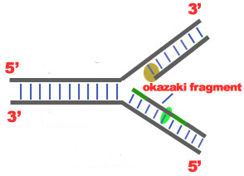
Lagging Strand
Replicated away from replication fork
Create segments - Okazaki Fragment
Fragments are later connected

Slide 12
3’
5’
Which Template will be the leading strand?
Lagging strand?
5’
3’
What would be the complementary DNA strand for the following DNA sequence?
DNA 5’-CGTATG-3’

Slide 13
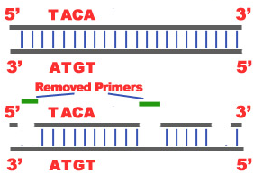
Joining
DNA polymerase removes RNA primer and fills with DNA nucleotide
DNA Ligase – links two sections of DNA together

Slide 14
Replication
DNA Helicase unzips DNA
RNA Primers bind to DNA strands
DNA Polymerase adds nucleotides to DNA
  Leading – continuous adding of bases
  Lagging – Okazaki fragments
DNA Ligase fills in gaps

Slide 15
SWEET VID!!
https://www.youtube.com/watch?v=TEQMeP9GG6M

Slide 16
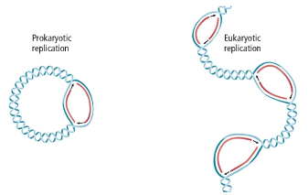
Prokaryote vs. Eukaryote
Prokaryotes
1 origin
Eukaryote
Many origins

Slide 17
Questions: put on a separate sheet of paper.
1. Replicate this strand of DNA:
ATGCAGTCGATG
TACGTCAGCTAC
2. If a DNA strand were to replicate, would they be the same or different? Why?
3. How does the structure of a DNA molecule help account for the great variety of life that exists on earth?

Slide 18
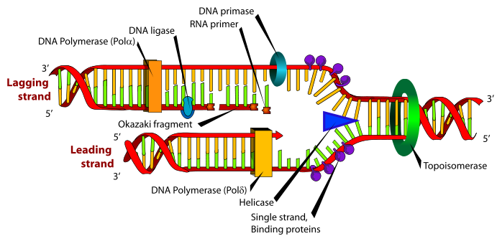

Slide 19
What do the following enzymes do: helicase, polymerase, ligase.
Agenda for Wednesday December 10th
Finish replication (go over questions)
Transcription
Translation

